Slide 1

Server Side APIs - Day 1
M2-D13
Participate! The more engagement the better! You are NEVER interrupting me!

Slide 2
Objectives
MVC (Model View Controller) Pattern
Spring Boot MVC Framework
Creating an Web Service with Spring Boot

Slide 3
An Introduction To The MVC Design Pattern
MVC is short for Model, View, and Controller.
MVC is a popular way of organizing your code. The big idea behind MVC is that each section of your code has a purpose, and those purposes are different.
Some of your code holds the data/logic of your app (Model), some of your code makes your app look nice(View), and some of your code controls how your app functions(Controller).

Slide 4
MVC (Model View Controller) Pattern
Model View Controller (MVC) is a pattern that divides the application based on responsibility.
Model
application state and business logic
only part of the application that talks to the database
Model could be classes
View
presents data to user
accept input from user
Views might be a desktop display, a mobile display, a file output based on a model
The View is not the output HTML/UI that displays in the browser or device, it is the code that generates the response.
Controller
Takes input from the view and passes it to the appropriate model objects
Grabs all necessary building blocks and organizes them for the output
Takes results from the model and passes it to the appropriate view
The end result is that the Model and View are unaware that the other exists. This decouples the Model and View.
The MVC Pattern is NOT only used for Web and Web Services. It is often used in other applications, and even exists in non-programming applications.

Slide 5
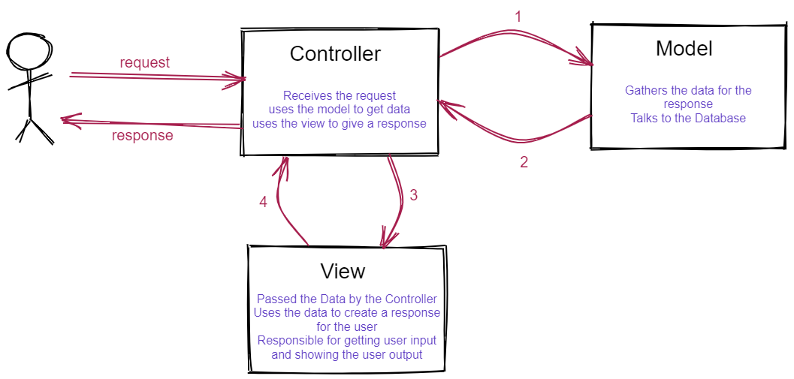

Slide 6
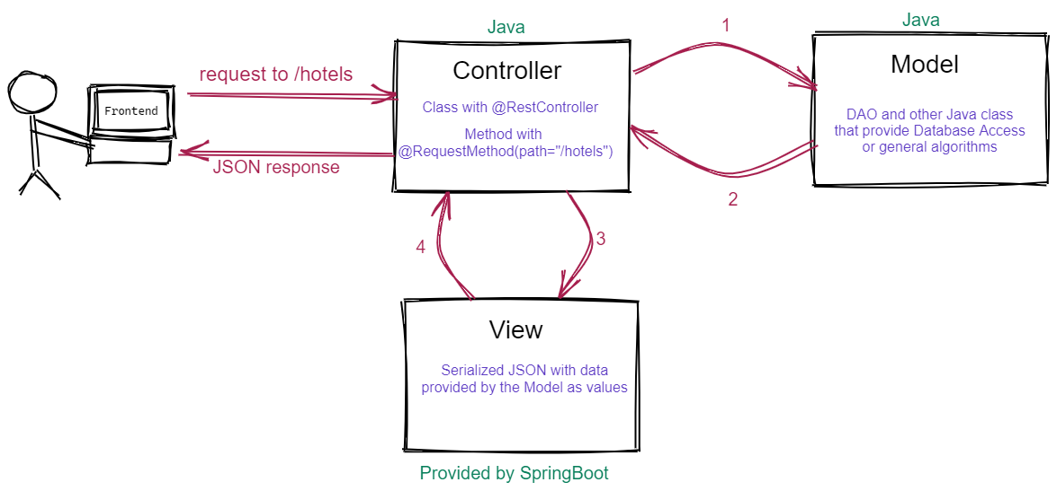
MVC in Spring Boot

Slide 7
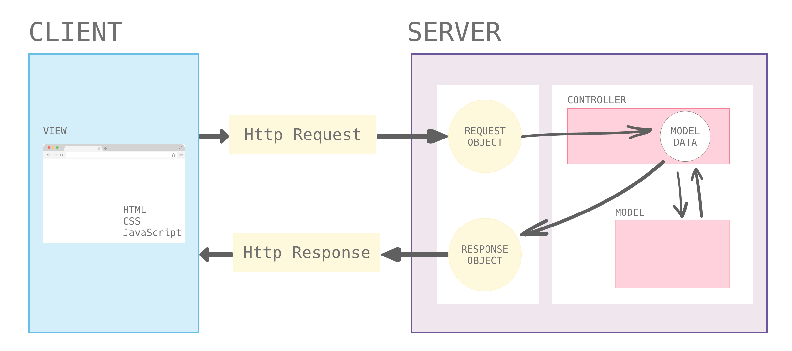

Slide 8
End Points (API)
list all hotels path: /hotels request method: GET return: list of all hotels in the system
get hotel by id path: /hotels/{id} request method: GET return: reservation info for given id using path variable Error: 404 Not Found

Slide 9
End Points (API)
list all reservations path: /reservations request method: GET return: list of all reservations in the system Errors: 404,
get reservation by id path: /reservations/{id} request method: GET return: reservation info for given id using path variable Error: 404 Not Found
list all reservations by hotel path: /hotels/{id}/reservations request method: GET return: list of all reservations in the system by hotel
add new reservation path: /reservations request method: POST add a new reservation to the given hotel based on the request body
filter hotels path: /hotels?state={state}&city={city} request method: GET find hotels by state and city (optional)
update reservation path: /hotels/{id}/reservations/{resId} request method: PUT Updates a specific reservation

